Slide 1

WILCOXON TEST
In class session

Slide 2
OUTLINE
Introduction
Exact and Approximate Methods

Slide 3

1. INTRODUCTION
Wilcoxon signed rank test is appropriate to use when the underlying measurement is on an ordinal scale.
It can be used as alternative to the paired t-test when the population cannot be assumed to be normally distributed.
Notes:
In the previous section you met the paired sample t test. However, there was one assumption that is not always applicable. What happens if the differences are not Normally distributed?

Slide 4
2. EXACT AND APPROXIMATE METHOD
sample set (N)
If N ≤ 15
Yes
No
Exact Method
Approximate Method
For large sample size, the exact and approximate p-value are very similar
For small sample size, the exact and approximate p-value can be quite different and can be lead to different conclusion about the hypothesis interest

Slide 5
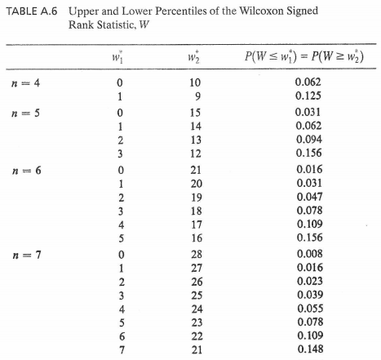
DETERMINE THE PROBABILITY OF W - TABLES
Table for EXACT method

Slide 6
HOW TO PERFORM WILCOXON TEST ?
Exact method
State the null hypothesis
Calculate each paired difference (D)
determining absolute difference |D|
Rank the differences
Calculate w⁺ and w⁻ to determine w₁ and w₂
Determine the probability distribution of w
Calculate P-value
Make a decision and conclusion

Slide 7
EXAMPLE 1 - EXACT
Feature 1
No. | Group A
1 | 191
2 | 173
3 | 176
4 | 168
5 | 195
6 | 182
7 | 196
Given the feature value of each group for this paired data
No. | F1-GA | F1-GB
1 | 191 | 186
2 | 173 | 171
3 | 176 | 177
4 | 168 | 168.4
5 | 195 | 191
6 | 182 | 177
7 | 196 | 191
No. | Group B
8 | 186
9 | 171
10 | 177
11 | 168.4
12 | 191
13 | 177
14 | 191

Slide 8
STATE THE NULL HYPOTHESIS
Given the feature value of each group below
No. | F1-GA | F1-GB
1 | 191 | 186
2 | 173 | 171
3 | 176 | 177
4 | 168 | 168.4
5 | 195 | 191
6 | 182 | 177
7 | 196 | 191
Null hypothesis : The feature has no significance difference

Slide 9

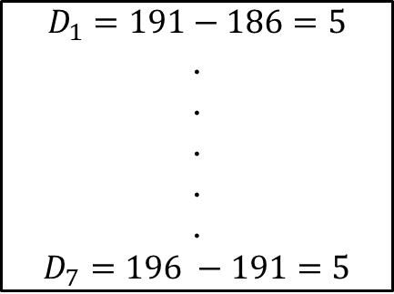
CALCULATE EACH PAIRED DIFFERENCE (D)
No. | F1-GA | F1-GB
1 | 191 | 186
2 | 173 | 171
3 | 176 | 177
4 | 168 | 168.4
5 | 195 | 191
6 | 182 | 177
7 | 196 | 191
D
5
2
-1
-0.4
4
5
5

Slide 10
DETERMINING ABSOLUTE DIFFERENCE |D|
No. | F1-GA | F1-GB
1 | 191 | 186
2 | 173 | 171
3 | 176 | 177
4 | 168 | 168.4
5 | 195 | 191
6 | 182 | 177
7 | 196 | 191
D
5
2
-1
-0.4
4
5
5
|D|
5
2
1
0.4
4
5
5

Slide 11

RANK THE DIFFERENCES
No. | F1-GA | F1-GB
1 | 191 | 186
2 | 173 | 171
3 | 176 | 177
4 | 168 | 168.4
5 | 195 | 191
6 | 182 | 177
7 | 196 | 191
D
5
2
-1
-0.4
4
5
5
|D|
5
2
1
0.4
4
5
5
Initial RANK | Final Rank
5 | 6
3 | 3
2 | 2
1 | 1
4 | 4
6 | 6
7 | 6
Notes:
How to decide rank? Build initial rank to decide the final rank

Slide 12
RANK THE DIFFERENCES
No. | F1-GA | F1-GB
1 | 191 | 186
2 | 173 | 171
3 | 176 | 177
4 | 168 | 168.4
5 | 195 | 191
6 | 182 | 177
7 | 196 | 191
D
5
2
-1
-0.4
4
5
5
|D|
5
2
1
0.4
4
5
5
RANK
6
3
2
1
4
6
6
Notes:
How to decide rank?

Slide 13
CALCULATE W1 AND W2
Sum of the positive signs
w⁺= 25
No. | F1-GA | F1-GB
1 | 191 | 186
2 | 173 | 171
3 | 176 | 177
4 | 168 | 168.4
5 | 195 | 191
6 | 182 | 177
7 | 196 | 191
D
5
2
-1
-0.4
4
5
5
|D|
5
2
1
0.4
4
5
5
RANK
6
3
2
1
4
6
6
Sum of the negative signs
w⁻ = 3
W₁ (min[w⁺,w⁻]) = 3
W₂ (max[w⁺,w⁻]) = 25

Slide 14
DETERMINE THE PROBABILITY OF W
Input values :
N (Total sample) = 7
W₁ = 3
W₂ = 25
Average these two P(W) to get the final P(W)
Probability distribution of W = P(W) = 0.039

Slide 15
CALCULATE P-VALUE
P(W) = 0.039
P-Value = 2 X P(W)
P-value = 2 X 0.039
P-Value = 0.078

Slide 16


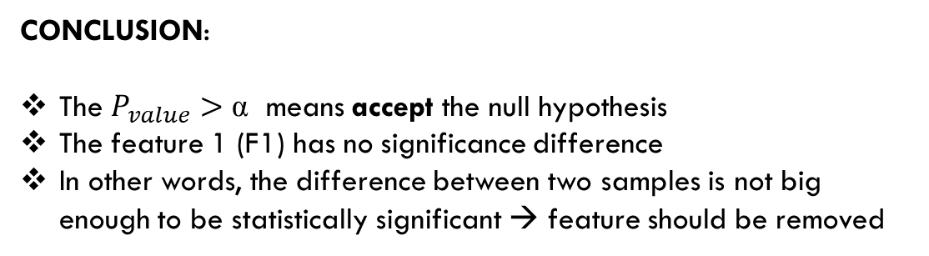
MAKE THE DECISION AND CONCLUSION
No. | F1-GA | F1-GB
1 | 191 | 186
2 | 173 | 171
3 | 176 | 177
4 | 168 | 168.4
5 | 195 | 191
6 | 182 | 177
7 | 196 | 191
DECISION
α= 0.05
Reject Alternative hypothesis

Slide 17
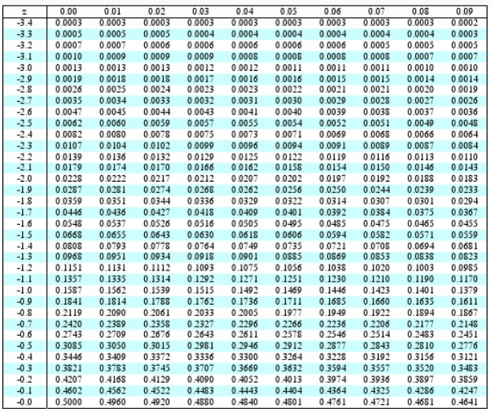
P-VALUE TABLES
Table for APPROXIMATE method
α

Slide 18
HOW TO PERFORM WILCOXON TEST ?
Approximate method
State the null hypothesis
Calculate each paired difference (D)
determining absolute difference |D|
Rank the differences
Calculate w⁺ and w⁻ to determine w_{stat}
Calculate Z-Score
Calculate P-value
Make a decision and conclusion

Slide 19
EXAMPLE 2 - APPROXIMATE
A study is made to determine whether the feature has a difference between two groups
No. | F1-GA | F1-GB
1 | 15 | 17
2 | 8 | 19
3 | 11 | 18
4 | 19 | 10
5 | 13 | 17
6 | 4 | 5
7 | 16 | 13
8 | 5 | 0
Continued…
No. | F1-GA | F1-GB
9 | 9 | 16
10 | 15 | 21
11 | 12 | 10
12 | 11 | 9
13 | 14 | 10
14 | 4 | 17
15 | 11 | 12
16 | 17 | 24

Slide 20
STATE THE NULL HYPOTHESIS
Given the feature value of each group below
Null hypothesis : The feature has no significance difference among two groups
No. | F1-GA | F1-GB
1 | 15 | 17
2 | 8 | 19
3 | 11 | 18
4 | 19 | 10
5 | 13 | 17
6 | 4 | 5
7 | 16 | 13
8 | 5 | 0
Continued…
No. | F1-GA | F1-GB
9 | 9 | 16
10 | 15 | 21
11 | 12 | 10
12 | 11 | 9
13 | 14 | 10
14 | 4 | 17
15 | 11 | 12
16 | 17 | 24

Slide 21
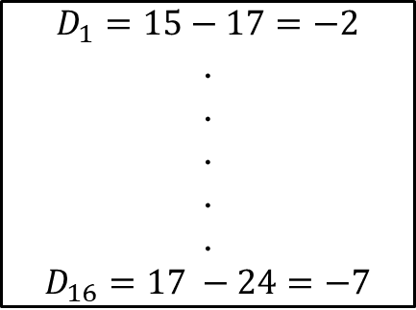
CALCULATE EACH PAIRED DIFFERENCE (D)
D
-2
-11
-7
9
-4
-1
3
5
-7
-6
2
2
4
-13
-1
-7
No. | F1-GA | F1-GB
1 | 15 | 17
2 | 8 | 19
3 | 11 | 18
4 | 19 | 10
5 | 13 | 17
… | … | …
… | … | …
16 | 17 | 24

Slide 22
DETERMINING ABSOLUTE DIFFERENCE |D|
No. | F1-GA | F1-GB
1 | 15 | 17
2 | 8 | 19
3 | 11 | 18
4 | 19 | 10
5 | 13 | 17
6 | 4 | 5
7 | 16 | 13
8 | 5 | 0
9 | 9 | 16
10 | 15 | 21
11 | 12 | 10
12 | 11 | 9
13 | 14 | 10
14 | 4 | 17
15 | 11 | 12
16 | 17 | 24
D
-2
-11
-7
9
-4
-1
3
5
-7
-6
2
2
4
-13
-1
-7
|D|
2
11
7
9
4
1
3
5
7
6
2
2
4
13
1
7

Slide 23
RANK THE DIFFERENCES
No. | F1-GA | F1-GB
1 | 15 | 17
2 | 8 | 19
3 | 11 | 18
4 | 19 | 10
5 | 13 | 17
6 | 4 | 5
7 | 16 | 13
8 | 5 | 0
9 | 9 | 16
10 | 15 | 21
11 | 12 | 10
12 | 11 | 9
13 | 14 | 10
14 | 4 | 17
15 | 11 | 12
16 | 17 | 24
D
-2
-11
-7
9
-4
-1
3
5
-7
-6
2
2
4
-13
-1
-7
|D|
2
11
7
9
4
1
3
5
7
6
2
2
4
13
1
7
Initial RANK | RANK
3 | 4
15 | 15
11 | 12
14 | 14
7 | 7.5
1 | 1.5
6 | 6
9 | 9
12 | 12
10 | 10
4 | 4
5 | 4
8 | 7.5
16 | 16
2 | 1.5
13 | 12

Slide 24


CALCULATE W1 AND W2
No. | F1-GA | F1-GB
1 | 15 | 17
2 | 8 | 19
3 | 11 | 18
4 | 19 | 10
5 | 13 | 17
6 | 4 | 5
7 | 16 | 13
8 | 5 | 0
9 | 9 | 16
10 | 15 | 21
11 | 12 | 10
12 | 11 | 9
13 | 14 | 10
14 | 4 | 17
15 | 11 | 12
16 | 17 | 24
D
-2
-11
-7
9
-4
-1
3
5
-7
-6
2
2
4
-13
-1
-7
|D|
2
11
7
9
4
1
3
5
7
6
2
2
4
13
1
7
RANK
4
15
12
14
7.5
1.5
6
9
12
10
4
4
7.5
16
1.5
12
Sum of the positive signs
w⁺ = 44.5
Sum of the negative signs
w⁻ = 91.5

Slide 25
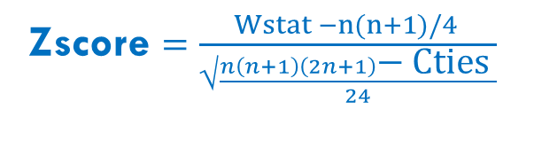
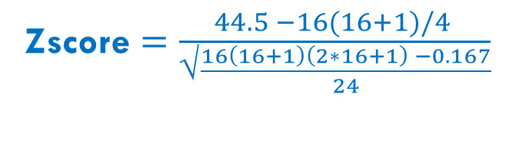
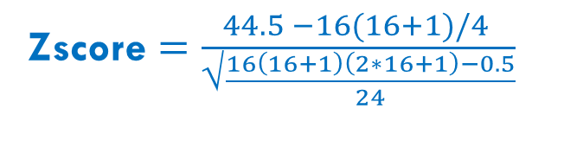


CALCULATE Z-SCORE
Notation | Meaning | Value
Wstat | min ( w⁺, w⁻) | 44.5
n | Sample size | 16
Cties

Slide 26


GET P-VALUE
-1.18266
0
1.18266
Z-Score = -1.18266
We got an area of 0.1251
The Z-table here is the left of the mean, because this is a two-sided test, so we had to double the actual result
p-value = 2x 0.1251 = 0.2502

Slide 27


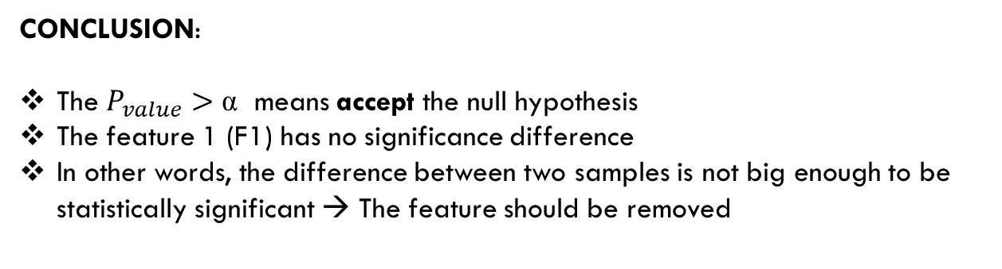
MAKE THE DECISION AND CONCLUSION
DECISION
α= 0.05
Reject Alternative hypothesis

Slide 28
WILCOXON TEST
Exact method
State the null hypothesis
Calculate each paired difference (D)
determining absolute difference |D|
Rank the differences
Calculate w⁺ and w⁻ to determine w₁ and w₂
Determine the probability distribution of w
Calculate P-value
Make a decision and conclusion
Approximate method
State the null hypothesis
Calculate each paired difference (D)
determining absolute difference |D|
Rank the differences
Calculate w⁺ and w⁻ to determine w_{stat}
Calculate Z-Score
Calculate P-value
Make a decision and conclusion

